Slide 1
MBTA Reliability and Accessibility

Slide 2
Agenda
Research problem
Understanding the data
Data cleaning
Exploratory data analysis
Application of models
Insights and Conclusion

Slide 3
Business Question
"How can we effectively address the reliability and accessibility issues within the Massachusetts Bay Transportation Authority(MBTA) public transit system in Boston to improve commuter experiences, minimize economic impacts and enhance overall urban mobility and productivity?"

Slide 4
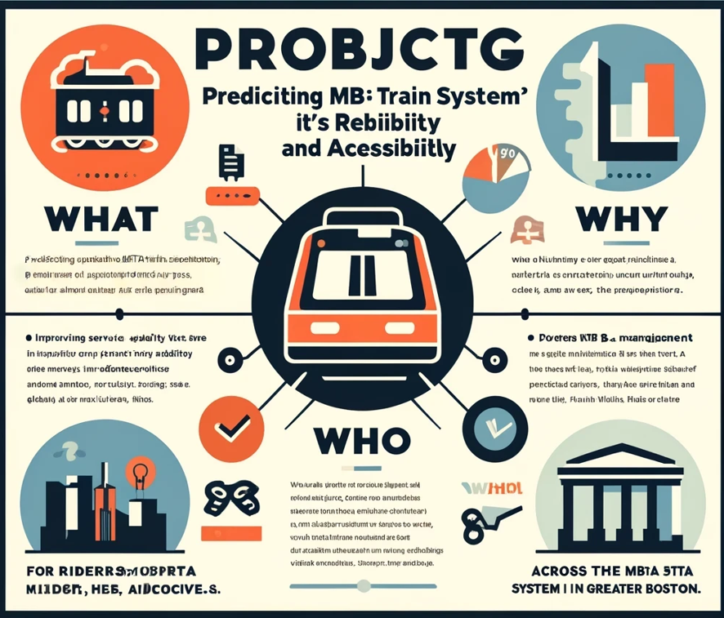

MBTA
RELIABILITY AND ACCESSIBILITY
Predicting MBTA train reliability and accessibility!!
Improving service quality for all riders
WHERE?
Boston’s Massachusetts Bay Transit Authority (MBTA) operates the 4th busiest subway system in the U.S. after New York, Washington and Chicago.
Riders,MBTA Management, Policy Makers, Advocates
Across MBTA system in Greater Boston Area

Slide 5
Data
Data Source : MBTA- massdot.opendata [2021-2023]
The source contains detailed ridership data for heavy rail and light rail. It contains the average ridership for a typical day during the rating by route/line, direction, stop, day type, and time period.
Source:https://mbta-massdot.opendata.arcgis.com/datasets/9fea7862501f4c59ab2c001ad6ae19b0_0/explore
Date
Station Name
Line
Gated entries
Customer Traffic

Slide 6
Data
Data Source : MBTA- massdot.opendata [2021-2023]
The source contains detailed ridership data for heavy rail and light rail. It contains the average ridership for a typical day during the rating by route/line, direction, stop, day type, and time period.
Source:https://mbta-massdot.opendata.arcgis.com/datasets/9fea7862501f4c59ab2c001ad6ae19b0_0/explore
Date
Station Name
Line
Gated entries
Customer Traffic
Mode Season Route name Direction Date | Day type Time period Total ONs Average Flow
Rail_Traffic

Slide 7
Data
Data Source : MBTA- massdot.opendata [2021-2023]
The source contains detailed ridership data for heavy rail and light rail. It contains the average ridership for a typical day during the rating by route/line, direction, stop, day type, and time period.
Source:https://mbta-massdot.opendata.arcgis.com/datasets/9fea7862501f4c59ab2c001ad6ae19b0_0/explore
Date
Station Name
Line
Gated entries
Customer Traffic
Mode Season Route name Direction Date | Day type Time period Total ONs Average Flow
Rail_Traffic
Total trip count
Ontime trip count
Trip date
Ride_Reliability

Slide 8
Data
Data Source : MBTA- massdot.opendata [2021-2023]
The source contains detailed ridership data for heavy rail and light rail. It contains the average ridership for a typical day during the rating by route/line, direction, stop, day type, and time period.
Source:https://mbta-massdot.opendata.arcgis.com/datasets/9fea7862501f4c59ab2c001ad6ae19b0_0/explore
Date
Station Name
Line
Gated entries
Customer Traffic
Mode Season Route name Direction Date | Day type Time period Total ONs Average Flow
MBTA_Data
Rail_Traffic
Total trip count
Ontime trip count
Trip date
Ride_Reliability

Slide 9
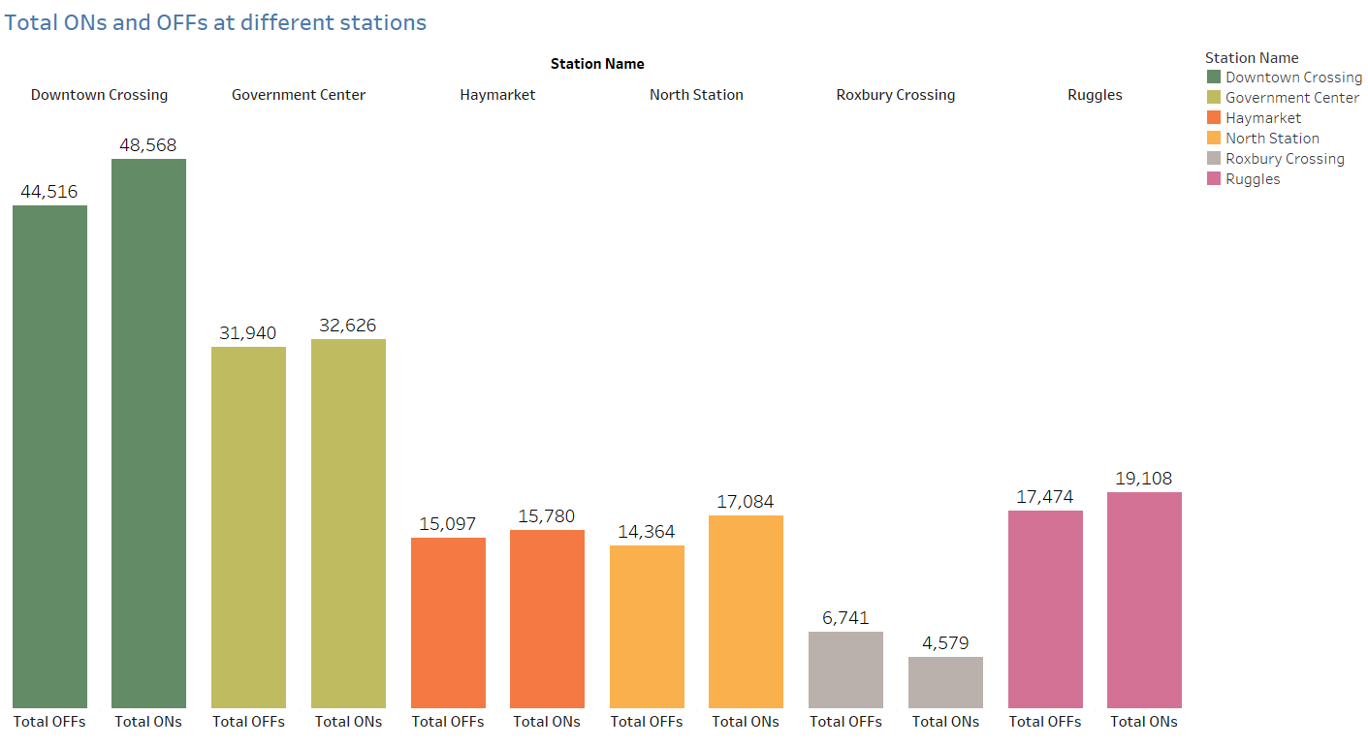
Exploratory Data Analysis

Slide 10
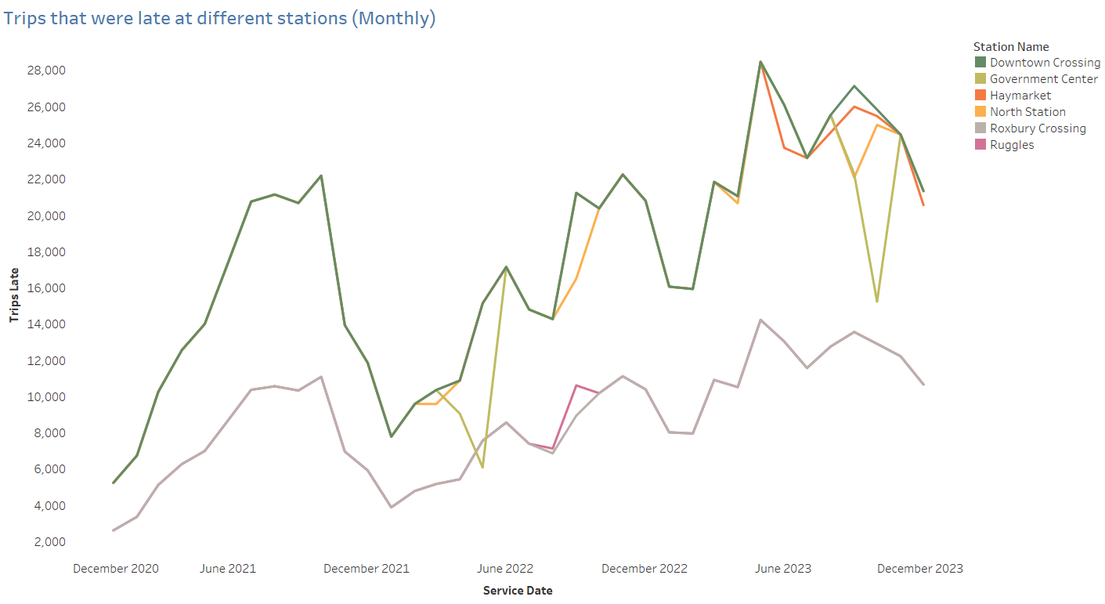

Slide 11
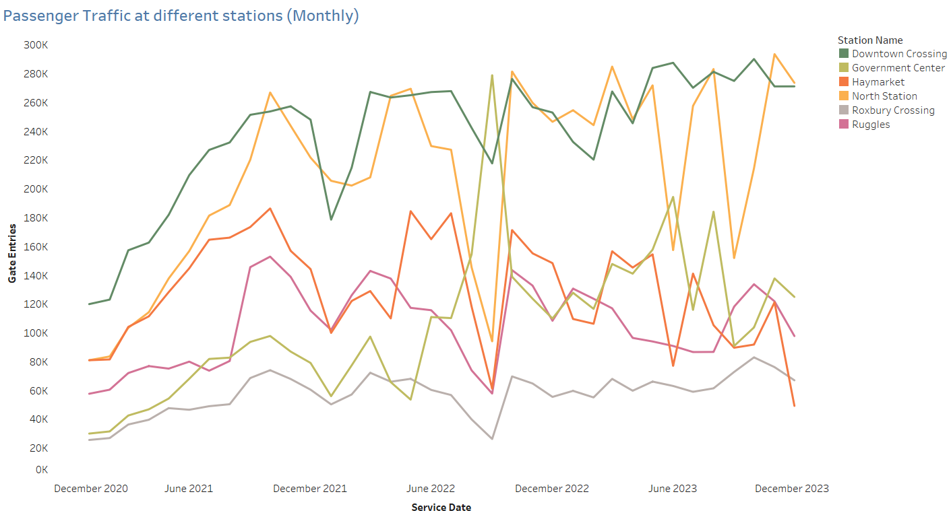

Slide 12
Cleaning and Preprocessing of Data
Time_Period : (04:00:00) —-> | Time_Period : 040000
Service Date : 15-12-2021 —-> | Service Date : 15122021
Extraction of year, time and date from Date Timestamp
Normalization of time_period - Eg: WHEN 'VERY_EARLY_MORNING' —> '5 AM - 6 AM'
Alias Names for columns for better understanding - Eg: total_ons as Total_ONs
Dropped all records with null values
Scaled the data for PCA and dummied the data to handle categorical values

Slide 13
Applying Models
Reliability:
Target Variable: Serious?_Yes
Predictor Variables: 'Service_Date','Station_Name','Line', 'Gate_Entries', 'Total_Trips'
Linear Regression
Decision Tree

Slide 14
Applying Models
Reliability:
Target Variable: Serious?_Yes
Predictor Variables: 'Service_Date','Station_Name','Line', 'Gate_Entries', 'Total_Trips'
Linear Regression
Decision Tree
Accessibility:
Target Variable: Average_ONs
Predictor Variables: 'Service_Date','Station_Name','Line', 'Mode', 'Direction_ID', 'Day_Type', 'Rail_Time'
Linear Regression
Principal Component Analysis

Slide 15
Reliability of MBTA
Is there reliability issue in Boston MBTA?
Our Approach to find ride reliability in MBTA is Linear Regression to identify factors affecting train system reliability.
Created dummy variables for categorical data (stations and lines) to fit the linear model.
Split data into training (70%) and testing (30%) sets for model accuracy.

Slide 16
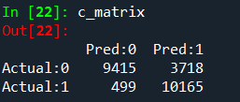
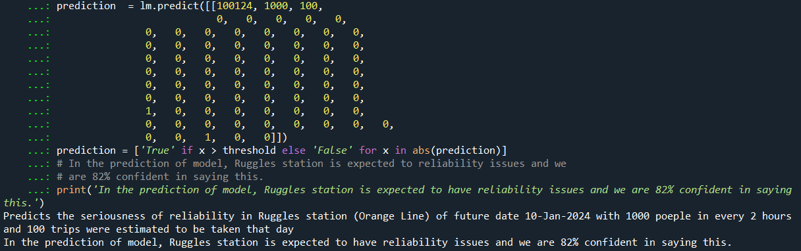
Model Accuracy: Achieved an 82% accuracy in predicting serious reliability issues
Performance Metrics:
Accuracy score is 82%,F1 score of 82%, Precision of 95%, and Recall of 73%, indicating the model's effectiveness and areas for improvement.
Example: Estimated significant reliability issues at Ruggles Station on 10-Jan-2024, based on traffic and trip data.
In the prediction through this model, Ruggles station is expected to have reliability issues and we are 82% confident in saying this

Slide 17
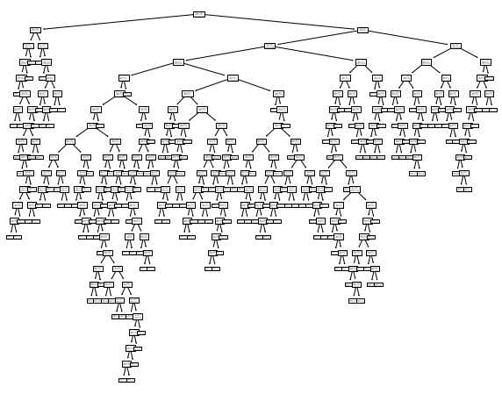
Decision Tree Analysis for Predicting MBTA Train System Reliability
Model Accuracy: Achieved 100% F1 score on both training and testing sets initially which indicating a perfect match in predictions.
However, such a high score suggests the model is overfitted to the training data, making it less likely to generalize well to unseen data.

Slide 18
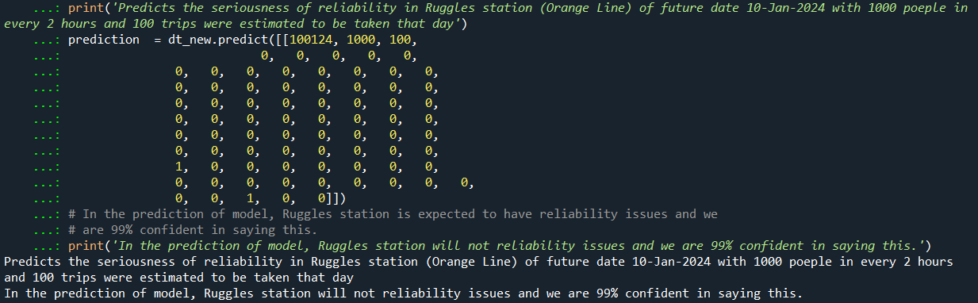
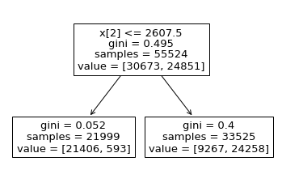
Model Overfitting and Adjustment
Overfitting Issue? (f1 score - 100%)
Hyperparameter Tuning- we got 99% even after doing GridSearchCV which is still overfitting.
Example: For Ruggles Station on 10-Jan-2024, based on simulated data, the adjusted model predicts significant reliability issues, with 99% confidence.
In the prediction through this model, Ruggles station will not have reliability issues and we are 99% confident in saying this.
Gave the best split root to be based on “Total Trips”

Slide 19
Accessibility of MBTA
Is there accessibility issues in Boston MBTA?
Our Approach is using Linear Regression to identify factors affecting train system accessibility.
Target Variable - No of people Boarding (Total_ONs)
Created dummy variables for categorical data (stations and lines) to fit the linear model.
Split data into training (70%) and testing (30%) sets for model accuracy
We are aiming to determine the number of individuals who will utilize the train within a given day in a specific time frame.(like how many people will take the train every 2 hrs)

Slide 20
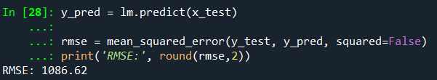
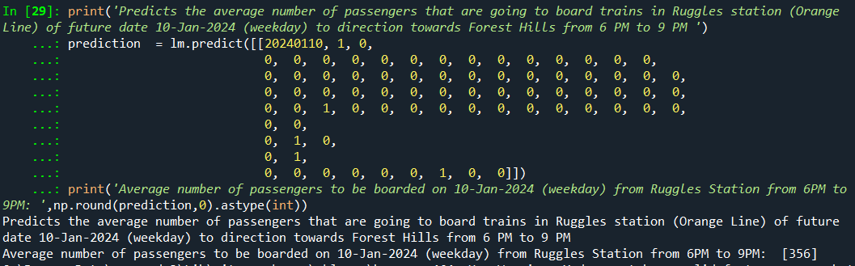
Model Accuracy: RMSE of 1086.
Example: Estimated the average number of passengers boarding trains at Ruggles station (Orange Line) heading towards Forest Hills between 6 PM and 9 PM on January 10, 2024 (weekday).
On a weekday between 6 PM and 8 PM, it is estimated that 326 individuals will board the train at Ruggles station.

Slide 21
Principal Component Analysis for Predicting MBTA Train System Accessibility
Predictor variables considered — Service_Date','Station_Name','Line', 'Mode',
'Direction_ID', 'Day_Type', 'Rail_Time','Average_ONs'
Created dummies for the variables
Data was scaled to normalize it, remove the effect of overshadowing, explain variance clearly.
10 components were considered — Variance = 21%
When Linear regression model was fitted - gave an RMSE of 770.
Even though the RMSE is observed to have improved, we cannot go forward with this method currently as it only explains 21% of the variance in data

Slide 22
Insights and Conclusions
Our forecasts will determine the reliability of stations on particular days. In instances of unreliability, our predictions from the accessibility model can estimate the number of affected individuals.
The project's predictive models forecast station reliability and potential rider impacts, crucial for proactive management. Insights could guide MBTA in policy decisions and operations, like optimizing service frequencies.
Overall, our project offers actionable insights for enhancing rider experiences and system efficiency, serving as a foundation for targeted interventions and ongoing performance monitoring of the MBTA.

Slide 23
Station
Reliable
Not Reliable
Advising MBTA to increase the frequency accordingly
Accessibility
No. of people getting affected by the delays

Slide 24
Thank You

